Slide 1
Code Like A Pro
Computing Science (Software Development)
Industry in the Classroom Virtual Engagement
Notes:
These slides are designed to be used by volunteers from software development backgrounds.
The content is intended to be suitable for students working towards a National qualification in Computing Science, in particular the “Software Development” Unit.

Slide 2
My name is:
Eleanor (Ellie) Dee
I am a:
Software Engineer
I work at:
Big Grid Industries
Notes:
Volunteer 1 to customise.
Photo by ThisisEngineering RAEng on Unsplash

Slide 3
My name is:
Eleanor (Ellie) Dee
I am a:
Software Tester
I work at:
Big Grid Industries
Notes:
Volunteer 2 to customise.
Photo by ThisisEngineering RAEng on Unsplash

Slide 4
What is Software Engineering?
“Software engineering is the process of analysing a problem and then designing, building, and testing software to solve that problem.”
Notes:
Volunteer X
We all work in software engineering.
“Software engineering is the process of analysing a problem and then designing, building, and testing software to solve that problem.”
There’s lots of different jobs in software engineering to make this all happen.

Slide 5
What does Big Grid Industries do?
We design and build technology solutions, covering software, cloud, data, AI and automation using Agile methodology
Notes:
Volunteer to customise.

Slide 6
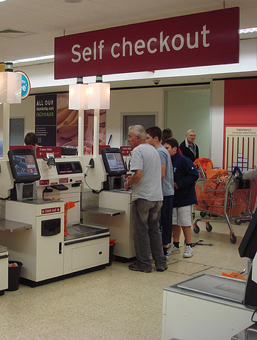
What am I working on at the moment?
I’m helping a retail chain create software for a new type of self checkout.
I work with the business analysts to understand everything the customer has to be able to do.
Then I write code which can be used by the new type of checkout.
Notes:
Volunteer to customise.

Slide 7
Code Review What do you think we do? Take a guess
Notes:
Volunteer X
Today we’re going to talk to you about a really important step in creating software.
Every time a developer is finished with a piece of code for a feature, we do something called a code review.
What do you think a code review is? Have you heard of them before? Don’t worry if not, you can take a guess.
I’ll give you a clue - we’re not giving the code a rating out of 5 stars!
—
At least one other developer will look at the code to see if they can understand it. It’s a type of peer review, I’m sure you do this sometimes - marking each other’s work.
We share our code with another developer and they will see if it does what it’s supposed to do, check for any obvious mistakes, and generally look at the quality of the code.

Slide 8
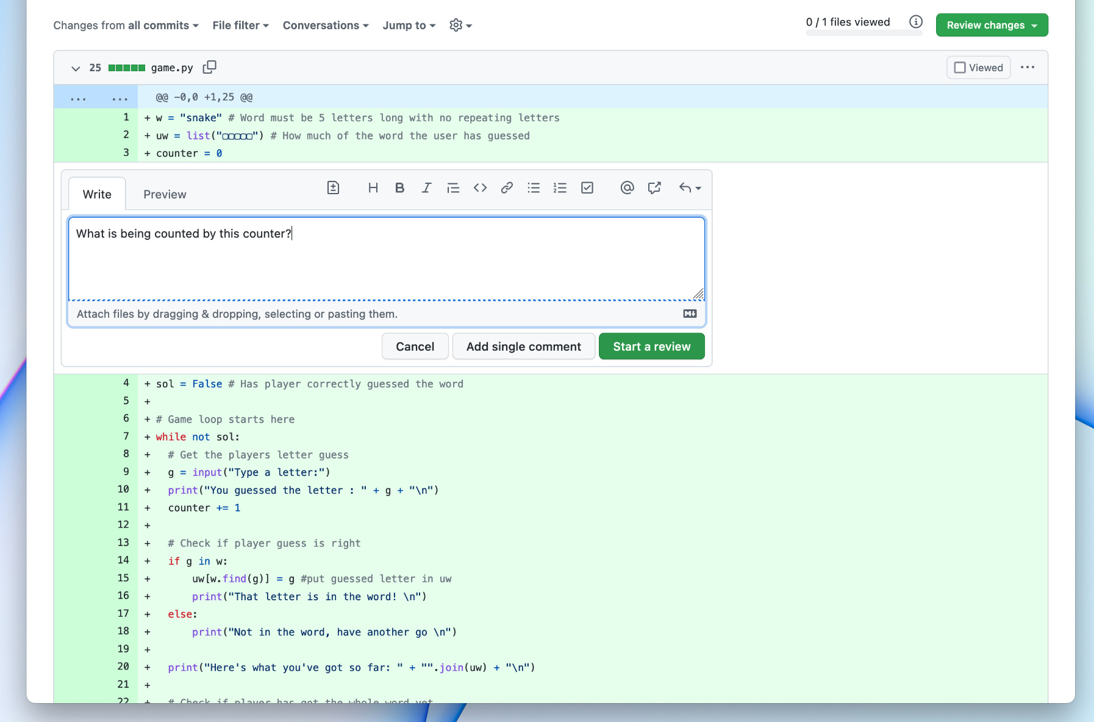
Notes:
Volunteer X
Here’s what a code review might look like. Once some code has been written, we send it to someone else to look at. They can leave a comment on any line by pressing the +, it’s a bit like Google Docs.

Slide 9
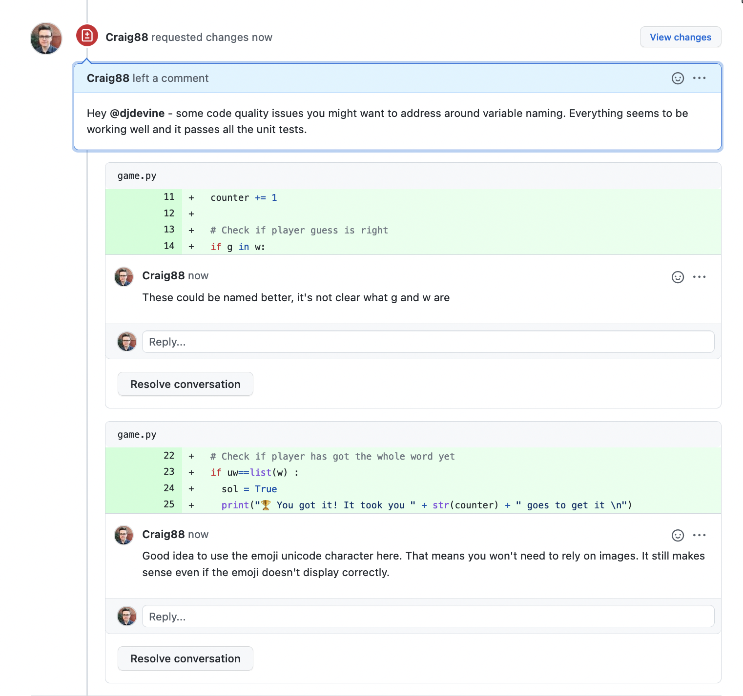
Volunteer X
Notes:
Volunteer X
When they’re done, the original developer can see all of the comments and changes requested by the reviewer.
Look here, we can see that Craig has said there are ‘some code quality issues you might want to address around variable naming’, and it even shows the parts of code where specific comments were made.
What I’d do next as the software developer is either reply for more information, or make the changes.
Then they get submitted again for review - hopefully this time it’s all positive comments!
The developer may not agree with everything that the reviewer has said. For example another reviewer may disagree on the use of emojis here, since emojis might not display correctly on the command line.

Slide 10
What are we looking for?
What makes good code?
1 minute
Choose your top 3 characteristics of good code
Easy to read
Number of lines (shortest)
Bugs (fewest number)
Fastest to run
Security
Portability
(runs on different devices)
Easy to maintain
Notes:
Volunteer X
What do you think makes good code? What are we looking for in a code review? What makes good code?
Take 1 minute to choose your top 3.
“Teacher name, could you time us for a minute?”
Okay great, tell us in the chat your top 3!
*discuss*

Slide 11
What does Google tell their developers to do?
In doing a code review, you should make sure that:
The code is well-designed.
The functionality is good for the users of the code.
Any UI changes are sensible and look good.
Any parallel programming is done safely.
The code isn’t more complex than it needs to be.
The developer isn’t implementing things they might need in the future but don’t need now.
Code has appropriate unit tests.
Tests are well-designed.
The developer used clear names for everything.
Comments are clear and useful, and mostly explain why instead of what.
Code is appropriately documented
The code conforms to our style guides.
Make sure to review every line of code you’ve been asked to review, look at the context, make sure you’re improving code health, and compliment developers on good things that they do.
Example from Google Eng. Practices
Notes:
[the point of this slide isn’t to exhaustively read the list, it’s to give a feel for ‘real world practices’]
Volunteer X
Well this is what Google does in a code review. This is the real documentation that Google developers have to follow.
Just looking at this list really quickly, they talk about things like “the code is well-designed, the code isn’t more complex than it needs to be, the developer used clear names for everything, comments are clear and useful”
Look at the paragraph at the bottom “Make sure to review every line of code you’ve been asked to review, look at the context, make sure you’re improving code health, and complement developers on good things that they do” It’s not an exam, it’s about helping each other write better code.
It’s not about finding bugs, or how fast it runs, it’s all about making readable code. Which is one of most important skills you need to be a software developer.

Slide 12
Why does readability matter?
Easier to find and fix bugs
We work in teams
Code can last for years
Other people need to be able to extend or add new features
Notes:
Volunteer X
Good code is all about readability.
Here’s why it matters.
If code is readable, and easy to understand - we can find and fix bugs much more easily.
We work in teams, so if someone can’t understand it, they can’t contribute!
Good code will be around for a long time, so people in future need to be able to extend it, or add new features.
Imagine if the code wasn’t readable, we’d end up starting over and over again - that would be slow, and expensive.

Slide 13
JavaScript - What does this do?
// get input from the user
const data_in = prompt(“Value to convert: “)
// convert to new units
const data_out = data_in * 0.621371
// tell user the answer
console.log(‘${data_out}’);
Example from programiz.com
Notes:
Volunteer X
Let’s look at an example of some code.
Have any of you ever used JavaScript before? Tell us in the chat!
If code is well written, we should be able to understand it, even if we don’t know the language.
What do you think this code does? Leave a message in the chat.
Do you think it’s good code? It has comments, it’s spaced out.
I’d say this code could be better, we don’t know what it’s converting do we. What is the data_in? And what is the data_out? We just don’t know the context.

Slide 14
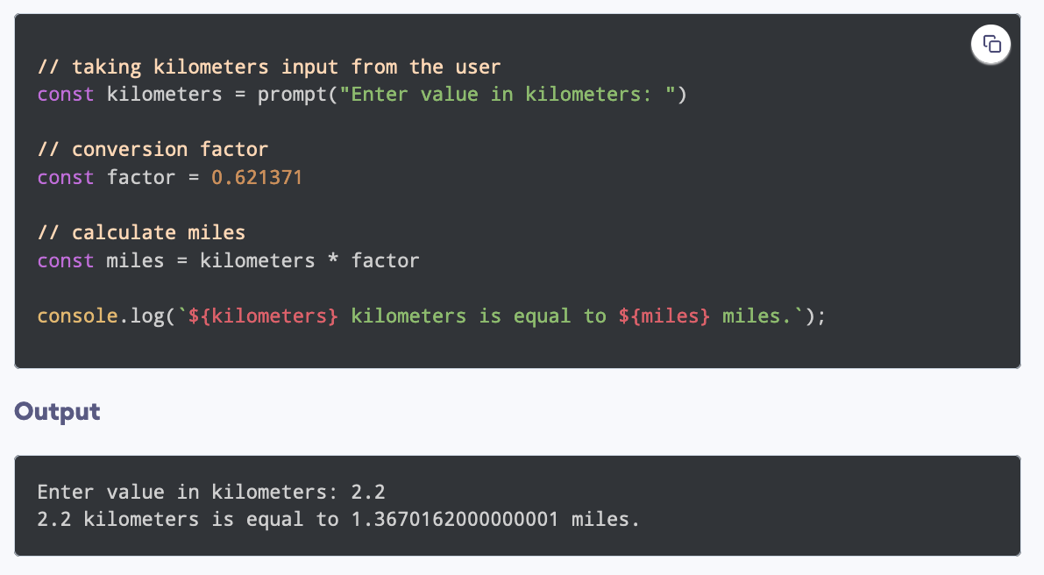
JavaScript - What if it was more readable?
Example from programiz.com
Notes:
Volunteer X
Here’s the code again, but with different variable names.
Tell me in the chat what the program does, is it what you expected?
Do you think you’d now be able to change it to convert kilometres to metres, or anything else?

Slide 15
Swift (iOS, macOS) - What does this do?
let door = true
let scan = false
if door && scan {
print(“Welcome!”)
} else {
print(“ERROR”)
}
Example from Apple
Notes:
Volunteer X
Let’s look at one more example.
Have any of you ever heard of Swift? It’s what apps and programs for Apple devices are made in.
What do you think this code does? Leave a message in the chat.

Slide 16
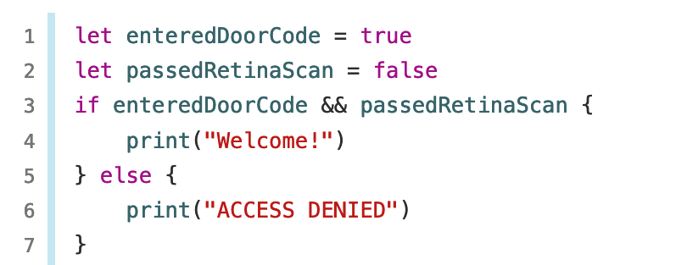
Swift - What if it was more readable?
Example from Apple
Notes:
Volunteer X
You can read this code out aloud, it makes sense!
It’s the same code, but with better variable names, it’s just like english. Good code should be what we call self-documenting, we try to write code so clear, it doesn’t even need comments to explain what’s going on.
If you needed to change the welcome message, could you do it? What line would you edit?

Slide 17
Guess a word
Each day there is a new 5 letter word to be guessed, letter-by-letter
Gameplay description:
Ask the player for a letter
Check if the letter is in today’s word If yes: Keep track of where in the word it is
Show how much of the word the player has guessed correctly
Check if the player has guessed the whole word If yes: Congratulations message If no: Go back to 1.
Notes:
Volunteer X
Let’s do a bit of a code review together.
We’ve got a small Python program that a developer has sent for code review. They’ve told us it works, and sent these rules along with the code.
Gameplay description:
Ask the player for a letter
Check if the letter is in today’s word
If yes: Keep track of where in the word it is
Show how much of the word the player has guessed correctly
Check if the player has guessed the whole word
If yes: Congratulations message
If no: Go back to 1.

Slide 18
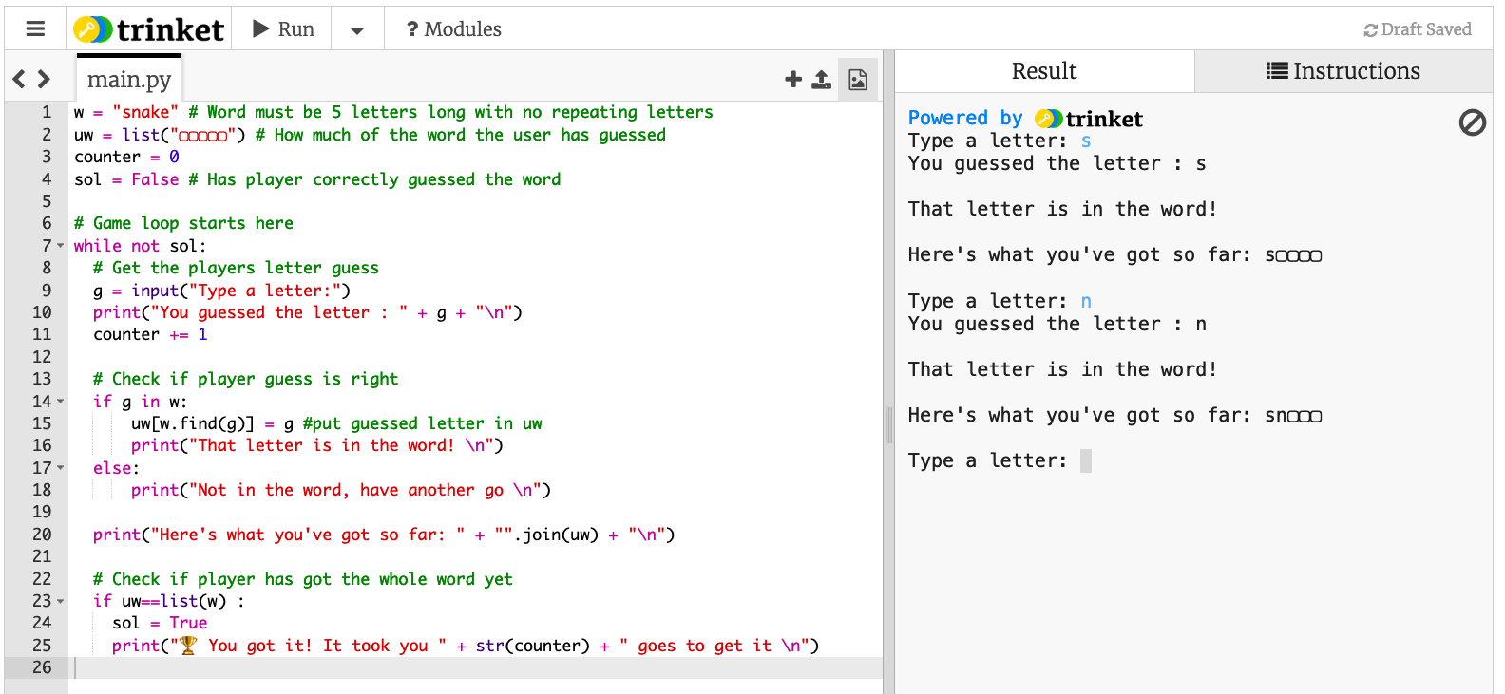
Notes:
[This image is a backup incase of issues with Trinket]
Open Trinket and screenshare https://trinket.io/python/6b3aa9d269
Run the code, and play the game together to make sure it’s working
Imagine this is a code review, and you’re the reviewer. In the chat tell us what comments you’d make. Tell us: the line number, and your comment
*discuss the comments and make some changes*
Some examples:
w -> mystery_word
uw -> solved_so_far
counter -> guesses_taken
sol -> solved

Slide 19
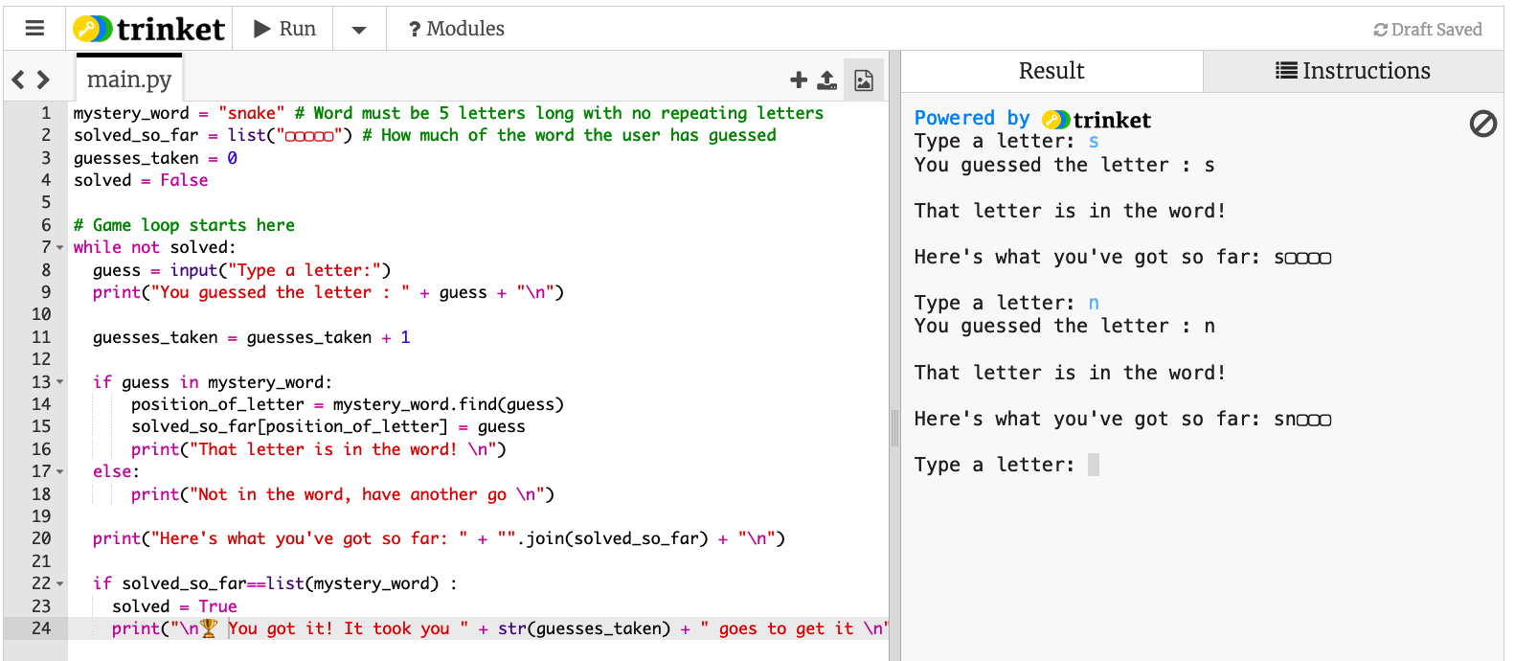

Slide 20
What did we change?
We used meaningful variable names
We gave the code a clean and clear structure
We followed Python naming conventions and style (PEP8)
We added internal commentary when necessary
Notes:
Volunteer X
Just with those changes, we made a big difference to the code. It’s so much more readable now.
We used meaningful variable names
We gave the code a clean and clear structure
We followed Python naming conventions and style (PEP8)
We added internal commentary when necessary
https://www.python.org/dev/peps/pep-0008/

Slide 21
What have covered?
What is a Code Review
Readability is really important
You were able to understand well written code in different languages
You helped improve some code to make it more readable
Notes:
Volunteer X
We’ve gotten through a lot!
What is a Code Review
Readability is really important
You were able to understand well written code in different languages
You helped improve some code to make it more readable
Good job!
Working in software development is a really great career, hopefully you know know a bit more about what we do, and the skills you need to have!

Slide 22
Q&A Ask The Expert
Notes:
FAQs
Salary for cyber security architects in Scotland: £50,000 - £80,000 (Skills Development Scotland)
Subjects to choose: Computing Science, NPA Cyber Security, Maths, Business Management
Routes: School-level qualifications, Apprenticeships (get paid while you learn), College courses, University courses, Informal learning opportunities
Where can I do this?: Every company that uses technology needs cyber security specialists
Locations: Lots of opportunities to travel as part of this job

Slide 23
Next Steps
Does your company offer apprenticeship programs? Or are they recruiting?
This is where you can share links with the young people.
Notes:
These are good web pages to direct pupils and teachers to.

Slide 24
Careers in Software Development
https://www.digitalworld.net/industries-and-jobs
https://www.digitalworld.net/software-development-careers
Notes:
These are good web pages to direct pupils and teachers to.

