Slide 1
Keeping The Lights On
NPA Data Security (Energy Sector)
Industry in the Classroom Virtual Engagement
Notes:
These slides are designed to be used by volunteers from data security roles in the energy sector.
The content is intended to be suitable for students working towards the National Progression Award in Cyber Security, in particular the “Data Security” Unit.

Slide 2
My name is:
Eleanor (Ellie) Dee
I am a:
Cyber Security Engineer
I work at:
Big Grid Industries
Notes:
Volunteers to customise.
Photo by ThisisEngineering RAEng on Unsplash

Slide 3
My name is:
Eleanor (Ellie) Dee
I am a:
Cyber Security Engineer
I work at:
Big Grid Industries
Notes:
Volunteers to customise.
Photo by ThisisEngineering RAEng on Unsplash

Slide 4
What do I do?
I make sure that electricity is available 24/7 for homes and businesses.
I ensure the electricity network is protected against cyber attacks.
Notes:
Volunteer to customise if necessary.

Slide 5
What is Data Security?
“Data Security is a branch of cyber security about protecting information stored within computer systems from cyber attacks or data breaches.”
Notes:
Today we’re talking about data security.
Data Security is a branch of cyber security about protecting information stored within computer systems from cyber attacks or data breaches.
What data do you deal with in your role?

Slide 6
Confidentiality - Only the right people can access the data
Integrity - The data is trustworthy, nobody can changed it
Availability - The data can always be accessed by approved people
Notes:
People working in data security often talk about the CIA acronym.
What we mean is we need to think about three things.
Confidentiality - Only the right people can access the data
Integrity - The data is trustworthy, nobody can changed it
Availability - The data can always be accessed by approved people

Slide 7
What does Big Grid Industries do?
We own and operate the cables, substations, pylons, and other infrastructure that brings electricity to homes, offices, and industry in Scotland.
It’s vital that electricity is always available. Imagine if an attacker could cause a blackout. We take cyber security really seriously.
Notes:
Volunteer to customise.

Slide 8
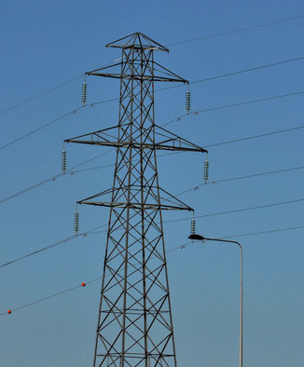
What am I working on at the moment?
I’m working with the smart grids team who are introducing a new control system. It will let the control room remotely control our substations.
I am selecting the best security measures to ensure nobody else can use the control system to cause damage or harm.
Notes:
Volunteer to customise.

Slide 9
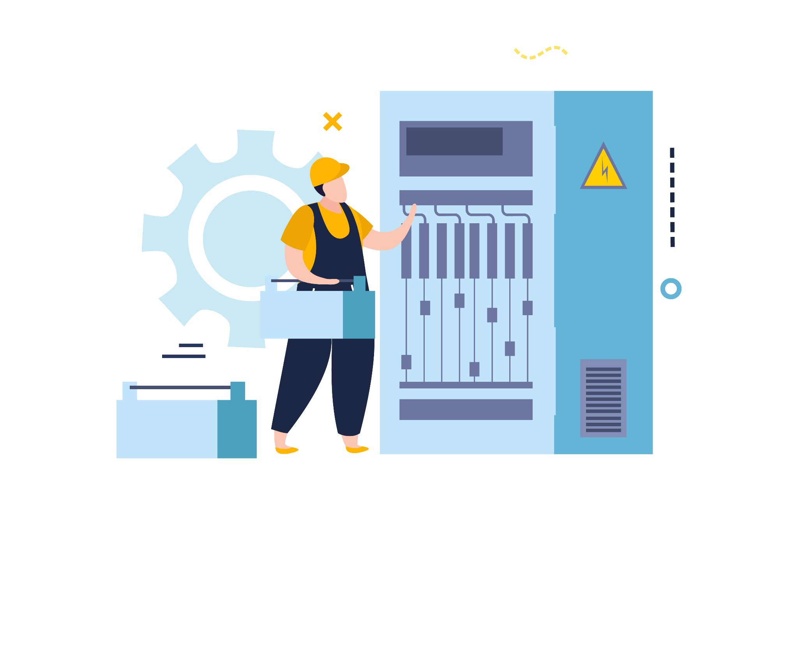
KEEPING THE LIGHTS ON
Notes:
Volunteer 1:
We’re going to do an activity together all about data security in our industry.
For us, keeping the lights on, keeping electricity available to everyone, is essential. We all rely on electricity, and society would quickly break down if we lost it.
We’re going to do a tabletop exercise together, something that real cyber security teams do on a regular basis.

Slide 10
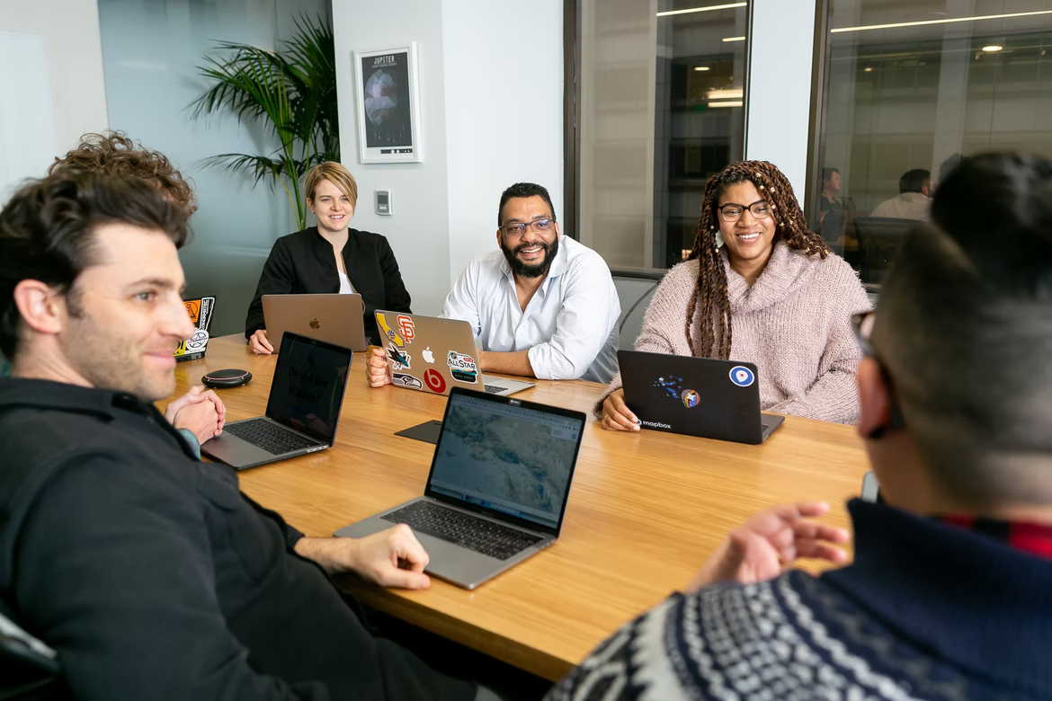
Tabletop Exercise
“What would we do if ___ happened?”
Notes:
Volunteer 2:
Tabletop exercises are meant to help organisations consider different risk scenarios and prepare for potential cyber threats.
Bring everyone together to discuss different scenarios, and talk about what could be done to mitigate, or reduce the risk.
Security teams do this type of exercise often. It’s all about communication.

Slide 11
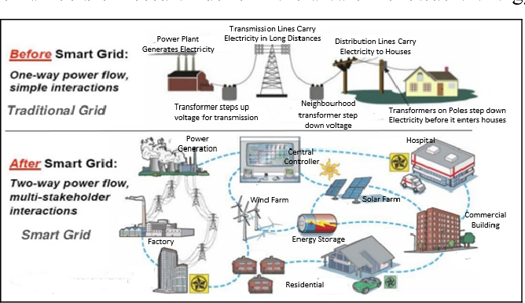
A Smart Grid
Notes:
Volunteer 1:
Before we start working through the tabletop scenarios, here’s what we’re protecting.
The electricity grid used to be quite simple, and operated using mechanical switches. Someone would have to drive to a substation, and pull a lever to change the flow of electricity. That made sense because we only had a few power stations and the electricity was predictable.
Nowadays, there’s so many different places electricity is generated. We still have big power stations, but there’s also wind farms, solar farms, and customers with solar panels. The amount of electricity is much more variable depending on the weather so we have to control it. It’s not possible to drive around and operate things manually. We need remote control and computer systems to make the grid ‘smart’.
A smart grid is much more susceptible to cyber attacks because there’s so many different computers, and in so many different locations. It’s a really big problem to keep it secure.

Slide 12
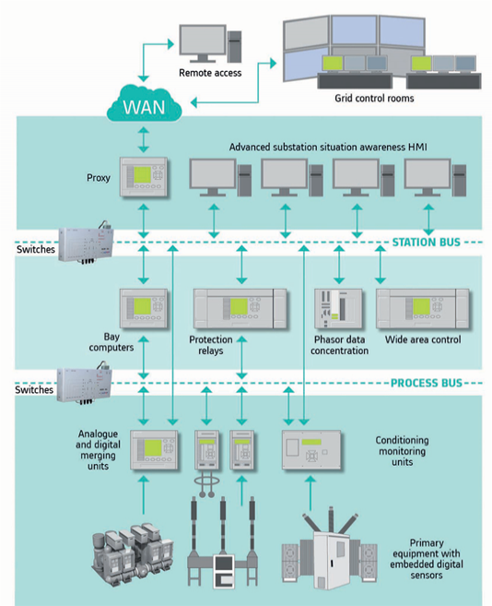
What are we protecting?
Notes:
Volunteer 2:
It’s not just computers we need to think about. There’s the computers and servers in the control room, but we have loads of different types of smart devices on our electricity network.
These devices are things like switches to turn electricity supplies on or off, or to redirect where the electricity is going. There’s devices which measure the flow of electricity. There’s also lots of what we call protection equipment which can turn off the power if a fault is detected. This is really important for everyone’s safety.

Slide 13
You’re representing the data security team.
Let’s walk through some scenarios.
Use your knowledge of data security to make recommendations that will keep our energy company and its data secure.
Notes:
Volunteer 1:
You’re representing the data security team.
Let’s walk through some scenarios.
Use your knowledge of data security to make recommendations that will keep our energy company and its data secure

Slide 14
Scenario 1: “Ofgem” is sending our staff malware that is known to target control systems. It looks like a press release.
Notes:
Volunteer 2:
A suspicious email account, pretending to be the regulator Ofgem is sending emails to everyone in the staff directory.
The emails contains a file titled “press release”, but actually contains a virus that targets our control systems.
Definite yes: Network Segmentation, Antimalware Software, Firewalls
But importantly for phishing: Staff Training/Culture

Slide 15
Scenario 1: “Ofgem” is sending our staff malware that is known to target control systems. It looks like a press release.
What security measures would help stop the malware from getting into the control system?
Hardware Network Segmentation Backups Keycard Access Port-locking Data encryption
Software Strong Passwords 2 Factor Authentication Antimalware Software Device Encryption Firewalls
Notes:
Volunteer 1 + 2 (together):
A suspicious email account, pretending to be the regulator Ofgem is sending emails to everyone in the staff directory.
The emails contains a file titled “press release”, but actually contains a virus that targets our control systems.
Definite yes: Network Segmentation, Antimalware Software, Firewalls
But importantly for phishing: Staff Training/Culture

Slide 16
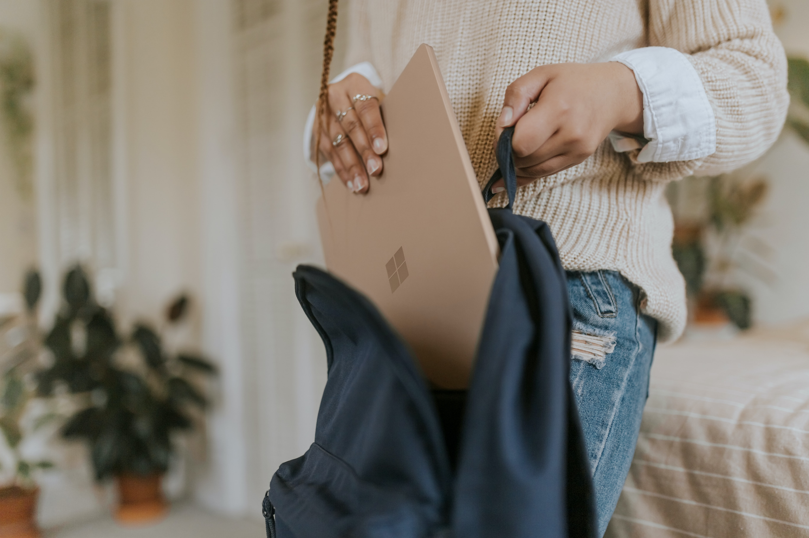
Scenario 2: A laptop used to remotely access the control room has been stolen
Notes:
Volunteer 1:
Why might someone steal the laptop?
To disrupt the network
Steal trade secrets
To sell to an organised crime group
To damage the reputation of the company (competitor)
Definite yes: Data encryption, Strong Passwords, 2FA, Device Encryption
To recover: Backups
To stop happening in the first place: Keycard Access, Security Culture, Policy (must be physically protected at all times - eg. in a locked house)
https://www.theguardian.com/world/2016/oct/10/mysterious-factory-break-in-raises-suspicions-about-chinese-visit

Slide 17
Scenario 2: A laptop used to remotely access the control room has been stolen
What security measures would help stop the thief from being able to access sensitive data?
Hardware Network Segmentation Backups Keycard Access Port-locking Data encryption
Software Strong Passwords 2 Factor Authentication Antimalware Software Device Encryption Firewalls
Notes:
Volunteer 1 + 2 (together):
Why might someone steal the laptop?
To disrupt the network
Steal trade secrets
To sell to an organised crime group
To damage the reputation of the company (competitor)
Definite yes: Data encryption, Strong Passwords, 2FA, Device Encryption
To recover: Backups
To stop happening in the first place: Keycard Access, Security Culture, Policy (must be physically protected at all times - eg. in a locked house)
https://www.theguardian.com/world/2016/oct/10/mysterious-factory-break-in-raises-suspicions-about-chinese-visit

Slide 18
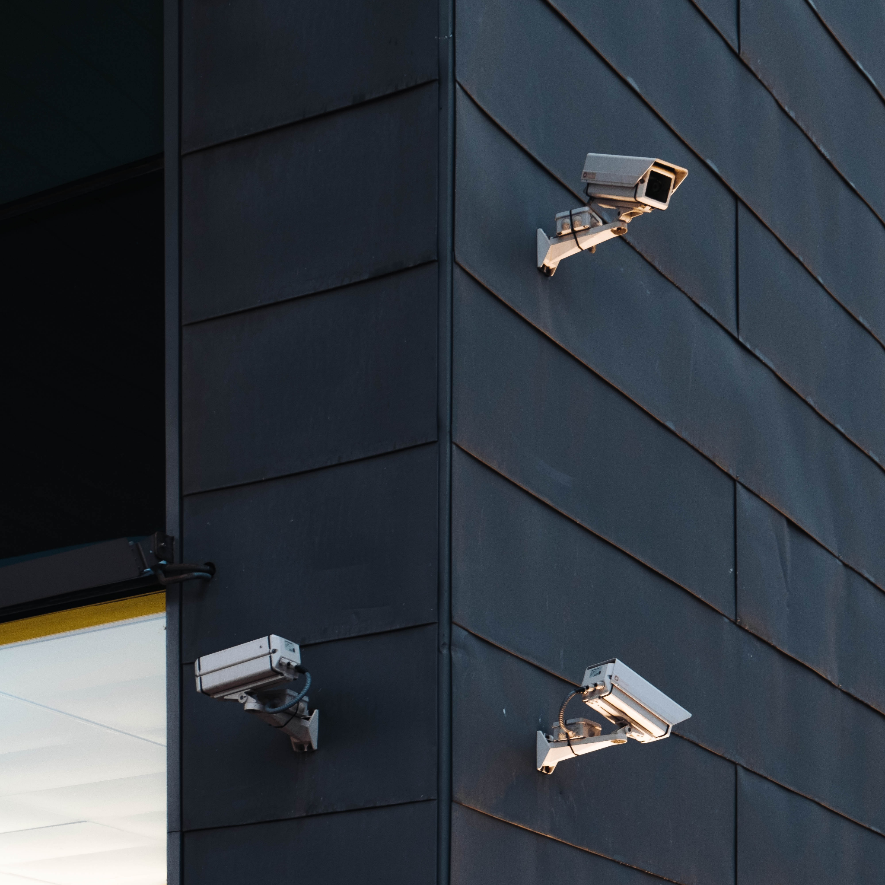
Scenario 3: An unrecognised person has been seen on CCTV inside the data centre. The keycard log shows them as an ex-employee.
Notes:
Volunteer 2:
Definite yes: Keycard Access, Data Encryption, Port Locking, Strong Passwords, 2FA Authentication, Device Encryption
Also: Security Culture (challenging people)

Slide 19
Scenario 3: An unrecognised person has been seen on CCTV inside the data centre. The keycard log shows them as an ex-employee.
What security measures would help stop the intruder from being able to access data?
Hardware Network Segmentation Backups Keycard Access Port-locking Data encryption
Software Strong Passwords 2 Factor Authentication Antimalware Software Device Encryption Firewalls
Notes:
Volunteer 1 + 2 (together):
Definite yes: Keycard Access, Data Encryption, Port Locking, Strong Passwords, 2FA Authentication, Device Encryption
Also: Security Culture (challenging people)

Slide 20
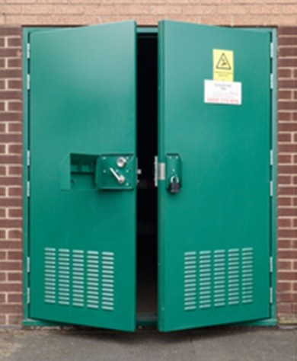
Scenario 4: A substation was left unlocked and a cyber criminal has entered.
Notes:
Volunteer 1:
Definite yes: Network Segmentation, Port-locking, Firewalls

Slide 21
Scenario 4: A substation was left unlocked and a cyber criminal has entered.
What security measures would help stop the criminal from being able to plug in their laptop and access the whole network?
Hardware Network Segmentation Backups Keycard Access Port-locking Data encryption
Software Strong Passwords 2 Factor Authentication Antimalware Software Device Encryption Firewalls
Notes:
Volunteer 1 + 2:
Definite yes: Network Segmentation, Port-locking, Firewalls

Slide 22
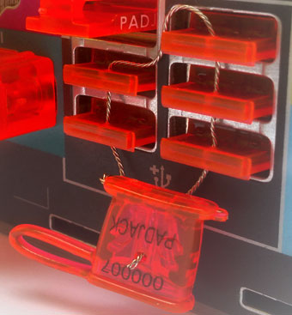
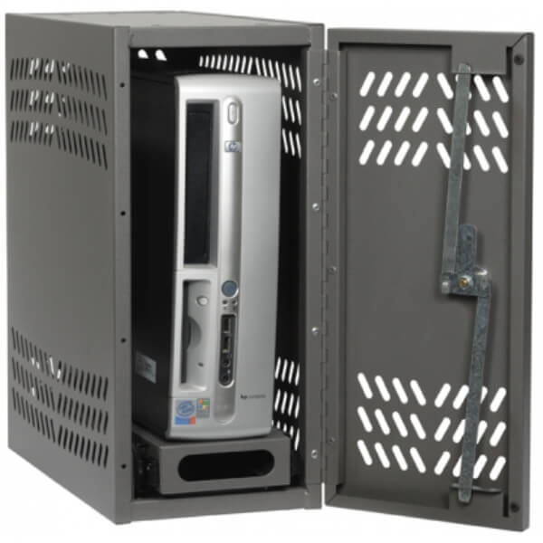
Notes:
Examples of physical port locking

Slide 23
Q&A Ask The Expert
Notes:
FAQs
Salary for cyber security architects in Scotland: £50,000 - £80,000 (Skills Development Scotland)
Subjects to choose: Computing Science, NPA Cyber Security, Maths, Business Management
Routes: School-level qualifications, Apprenticeships (get paid while you learn), College courses, University courses, Informal learning opportunities
Where can I do this?: Every company that uses technology needs cyber security specialists
Locations: Lots of opportunities to travel as part of this job

Slide 24
Next Steps
digitalworld.net/cyber-security-careers
(add your own websites here)
Notes:
These are good web pages to direct pupils and teachers to.
Do you have any corporate resources, or recruitment campaigns you’d like to share?

